Slide 1

Healthy Nurse, Healthy Massachusetts
Dr. Cathleen C. Colleran DNP, RN
Immediate Past President, ANA MA
Notes:
I bet you think I am going to lecture you about your diet, your exercise or lack there of… My goal to day is not to do either but to perhaps motivate yoou to think a little differently about your own health and well being.
When I attended the Membership assembly last June I was thrilled to hear about the ANA Healthy Nurse Healthy nation initiative that would be kicked off this month. I was determiend that as one of my goals as president woudl be to engage nurses in MA to be one of the first states in the nation to embrace this campaign.
We quickly adopted the Healthy Nurse Healthy MA theme.
I have been a nurse for 27 years now and have gone through all the same ups and downs with my health as all of you...sleepless nights working night shift, lunch and dinner on the run, working a double because the unit is short staffed..lifting pulling and pushing While trying to maintain all the other roles we have in our life...mother, father, spouse, student, caregiver to family

Slide 2
Notes:
I traveled last week to Aruba- One happy island with my daughter for New Years… and after having listened to the annoucnement about safetywhat felt like a million times, , it dawned on me that this is exatly what we do as nurses.....We put others first and ourselves last.. It does strike me as funny to thin I woud put a oxygen mask on my self before my child or even beofre the elderly perosn siting nexct tyo me... As a nurse we are caregivers firstr, we rarely thini of self care
Ladies and gentlemen, on behalf of the crew I ask that you please direct your attention to the monitors above as we review the emergency procedures. There are six emergency exits on this aircraft. Take a minute to locate the exit closest to you. Note that the nearest exit may be behind you. Count the number of rows to this exit. Should the cabin experience sudden pressure loss, stay calm and listen for instructions from the cabin crew. Oxygen masks will drop down from above your seat. Place the mask over your mouth and nose, like this. Pull the strap to tighten it. If you are traveling with children, make sure that your own mask is on first before helping your children. In the unlikely event of an emergency landing and evacuation, leave your carry-on items behind. Life rafts are located below your seats and emergency lighting will lead you to your closest exit and slide. We ask that you make sure that all carry-on luggage is stowed away safely during the flight. While we wait for take off, please take a moment to review the safety data card in the seat pocket in front of you.

Slide 3
What is a “Healthy Nurse”?
ANA defines a healthy nurse as “one who actively focuses on creating and maintaining a balance and synergy of physical, intellectual, emotional, social, spiritual, personal and professional wellbeing. A healthy nurse lives life to the fullest capacity, across the wellness/illness continuum, as they become stronger role models, advocates, and educators, personally, for their families, their communities and work environments, and ultimately for their patients”.

Slide 4
As the most trusted profession(again) we have the power to make a difference!
By choosing nutritious foods and an active lifestyle, managing stress, living tobacco-free, getting preventive immunizations and screenings, and choosing protective measures such as wearing sunscreen and bicycle helmets, nurses can set an example on how to BE healthy.
Notes:
We are trusted and respected, people look to us for advise and guidance…How odd is it that we educate others on how to care for themselces yet we neglect to care for our selves.
When was the last time you exercised? Read a book- for fun, planned a healthy meal for yourself? Or even took a walk.

Slide 6
“Health is not only to be well, but to use well every power we have. The martyr sacrifices themselves entirely in vain. Or rather not in vain; for they make the selfish more selfish, the lazy more lazy, the narrow narrower.”
      ~Florence Nightingale, 1893

Slide 7
Notes:
Nurses are taught to care for others; it is ingrained in their life purpose. However, in my experience, nurses often express reluctance to take the time required to care for themselves or they have difficulty finding self-care activities that match their interests and that are easily assimilated into their lives. Yet self-care can help one cope with stressors inherent to both practicing nurses and nursing students that can lead to exhaustion, tension, and fatigue (sometimes known as burnout), such as clinical decision-making and staffing concerns

Slide 8
Twelve steps towards a Balanced Life
Sharon Weinstein MS, RN
Define your overarching purpose
Simplify your life
Address your major stressors
Focus on possibilities
Increase engagement in life
Harness technology
Deal with fatigue
Gain a better balance at work
Improve sleep health
Living a healthy and happy life
Reinvent your life when necessary
Find destiny in balance
Notes:
Sharon Weinsten talks about Balance in life and how difficult it cann be to find a good work life balance especially as a nurse. She describes the balancing act includes carving out time for yourself, to tend to yoru own needs.
She states we are only as good as we are balanced.. If yiou don’t take the time for yourself, even with all the responsibilities that pressure you you wikll not be the best you can be.
She outliens 12 sterps starting with assessingn your current state and determine wihere you wat to take your life and find your purpoise, set your goals goals that will stretch you but not overwhlem you.

Slide 9
Barriers to Work-Life Balance
Internal vs. External barriers
Acknowledge things you cannot change
Embrace what you can change
  Perfectionism
  Empathy
  Take a “time out”
Effective time management
Build stronger relationships
Better self-care
One step at a time !!
      Boertje, J., & Ferron, L. (2013).
Notes:
Without a good work life balance wew run the risks of burnout and lon term begaitive ewffects on physical and mental health our relationships and our work performance.
Many nurses have a hard time maintaining balance du e to job demands, erratic work scheudles, or inability to sat no when asked.
Internal are the things within us- how we feel when caring for difficult patients, when a paitent gets a bad diagnosis
Acknowledge what you can and cannot change,
Perfection is necessary when it comes to patient care- we do howvere make mistakes, in llife and work, we need to be able to learn frm them and move on.
Empathy for others rather than judgement-seek to understanb others…
Time out, breath deep- mediation
Effective time management at home and work, negotiate expectations, ask for help, set limits on your time at work and at home,
Relationship problmes can be a great drain on your time and emotional energy-
Tak etime to care for yourself,
And cut your self some slack, be kind and compassionate to yourself- rome wasnt built in a day,
External are ourtside of our control- inadequate staffing or changes in practice , generational diffderences and expectations in the workforce

Slide 10
The Power of a Nurse
Most influential catalyst for health care reform in America, it is time for nurses to emulate wellness and prevention
    3.6 million in US and 120, 000 in MA
Creating healthy habits for ourselves, we flourish as ambassadors of self care for our patients, our families, colleagues and communities
By taking care of ourselves first, we bring positive energy and vitality to the workplace that will influence others.
Self-care should be an expectation for professional practice
Notes:
How can we influce the health of the nation??We are role models for others

Slide 11
ANA Code of Ethics
-Provision 5
“The nurse owes the same duties to self as to others including the responsibility to promote health and safety, preserve wholeness of character and integrity, maintain competence, and continue personal and professional growth”
  We have an ethical duty to care for ourselves in order to be able to effectively care for others.

Slide 13
What will you commitment be to yourself this year?
ANA provides various resources on the website that will aide nurses in maintaining health and preventing diseases.
Accessible to all registered nurses and RN students, ANA is providing a comprehensive health risk appraisal (HRA) in collaboration with Pfizer Inc, free of charge. This HIPAA-compliant HRA gives nurses real-time data on their health, safety, and wellness, personally and professionally. Nurses can compare their results to national averages and ideal standards. Upon completion of the HRA, nurses can access a web wellness portal. The HRA builds nursing data, inclusive of all ages and both sexes.
  http://www.nursingworld.org/MainMenuCategories/WorkplaceSafety/Healthy-Nurse/default.aspx
Notes:
My commitment to myself is …....

Slide 14
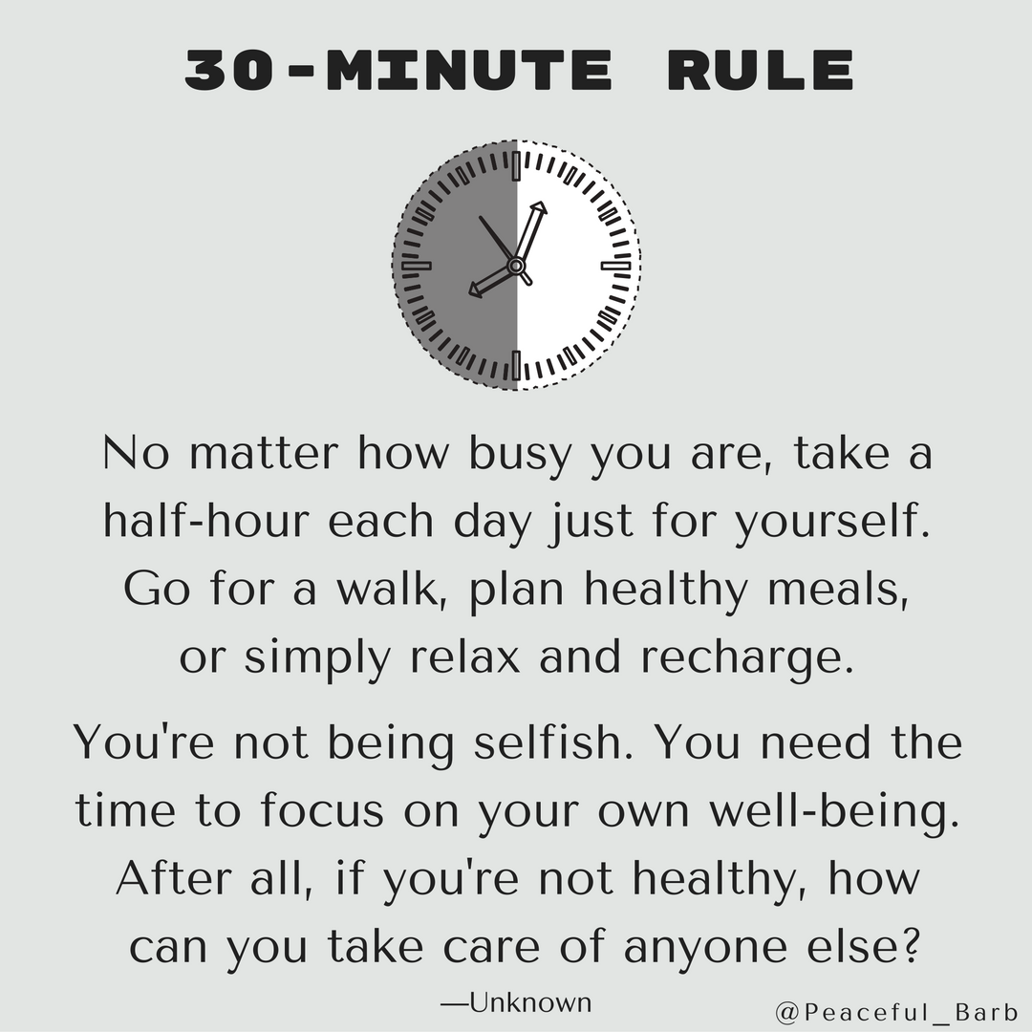

Slide 15


Slide 16
References
AJN, American Journal of Nursing: January 2012 - Volume 112 - Issue 1 - pp 25,26doi: 10.1097/01.NAJ.0000410173.98529.f6
http://www.nursingworld.org/MainMenuCategories/WorkplaceSafety/Healthy-Nurse
http://www.nursingworld.org/MainMenuCategories/EthicsStandards/CodeofEthicsforNurses/Code-of-Ethics-For-Nurses.html
Weinstein, S. (2015).B is for Balance: 12 Steps Towards a More Balanced Life at Home and at Work.2nd edition.
Boertje, J., & Ferron, L. (2013). Achieving a work-life balance. American Nurse Today.

