Slide 1

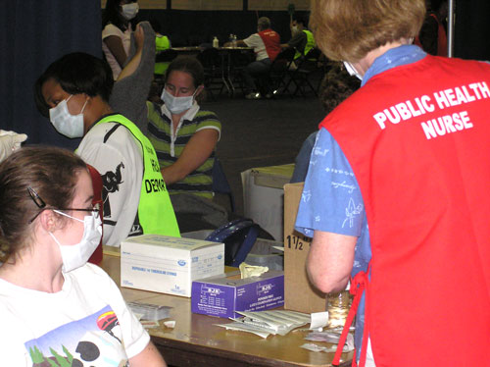
Public Health Nursing Workforce:
Looking toward and planning for the future
American Public Health Association
November 2, 2011

Slide 2
Presenter Disclosures
Deborah Chaulk, Glynnis LaRosa, Katherine Schmidt
The following personal financial relationships with commercial interests relevant to this presentation existed during the past 12 months:
No relationships to disclose

Slide 3
Survey Workgroup
Debbie Chaulk, MSN, RN, PHCNS-BC
Dawn Dewkett, DNPc, BSN, RN
Andy Ellingson, MPH
Glynnis LaRosa, MPH, RN, CPHQ
Kaydee Schmidt, MSN, MPH, RN
Notes:
3

Slide 4
Objectives
Enumerate the MA PHN workforce
Analyze changes of MA PHN workforce 2006 – 2010
Discuss strategies to assure equal access to PHN services

Slide 5
Introduction
PHNs are essential in improving the health of communities
PHNs are needed to:
  Address population health issues
  Reduce health disparities
  Create healthy social and physical environments
  Manage new and emerging health issues

Slide 6
Survey Methods
2006 First Survey
    Baseline data
2010 Second Survey
    Identify trends
    Document PHN/Population Ratio

Slide 7
Survey Methods
Voluntary pencil/paper
15-20 minutes to complete
Distribution
  2009 MA PHN annual conference
  MA PHN Regional chapter meetings
  Available on-line

Slide 8
Survey Methods
174 surveys returned
Covering 183 municipalities
Representing 80% of the population of the Commonwealth

Slide 9
MA PHN Profile
Age
Years of experience PH
Practice
Scope of practice
Education
Prior nursing experience
Language fluency
Screening/clinics/programs
Populations Served
Preparedness
Benefits
Compensation
Hours
Employment

Slide 10
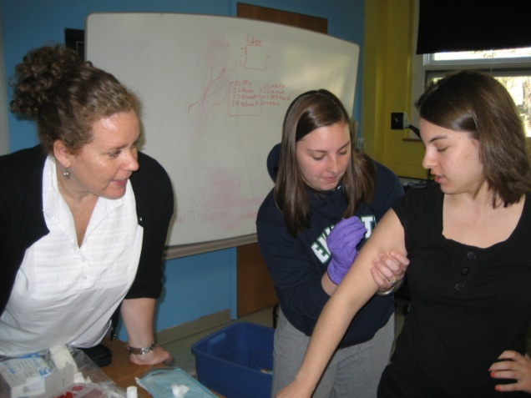
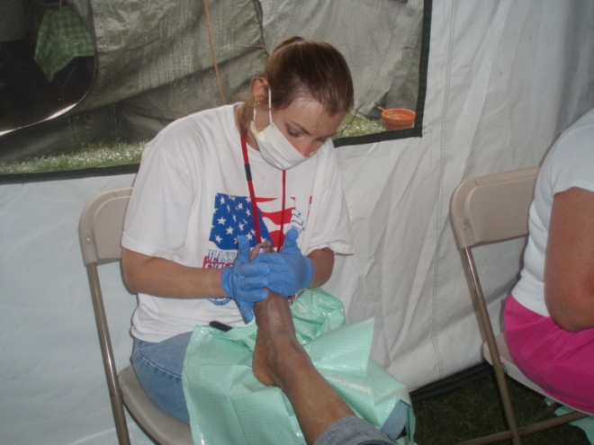

MA PHN Profile

Slide 11
MA PHN Average Age
HRSA 2010 The Registered Nurse Population Survey

Slide 12
Percent of MA PHNs >50 yrs and older

Slide 13
MA PHNs Educational Level

Slide 14
MA PHNs with Bachelor Degree or higher
HRSA 2010 The Registered Nurse Population Survey

Slide 15
Prior Experience
School Nursing
Parish Nursing
Emergency
Mental Health
Women’s Health
Pediatrics
Administration
HIV/AIDS
Obstetrics
Long Term Care
Men’s Health
Rehabilitation
Infectious Disease
Acute Care
International Health
Diabetes
Oncology
Home Health
Cardiology
Hospice
Health Education
Faculty
Environmental Health

Slide 16
MA PHN Language Fluency
22% responded that they speak another language

Slide 17
Years of practice
Past experience
Education
Expert PHNs

Slide 18



Employment

Slide 19
MA PHN
Average Hourly Rate 2006 / 2010
Bureau of Labor Statistics

Slide 20
MA PHN Hours Worked Per Week

Slide 21
Extra Hours per Week
79 PHNs worked for additional hours
  26 PHNs were paid for additional hours
  53 PHNs were not paid for additional hours
  (average 5 hours/week)
  This represents $313,656 of unpaid service per year

Slide 22
Benefits
Health insurance
Travel expenses
Paid sick time
Liability insurance
Membership dues

Slide 23
Retire Within 2-4 years?
7% responded they will retire in 2 years
14% responded they will retire in 4 years
Projection of 21% retiring within 4 years

Slide 24
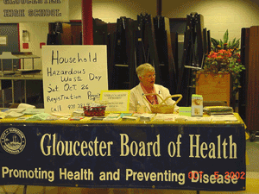
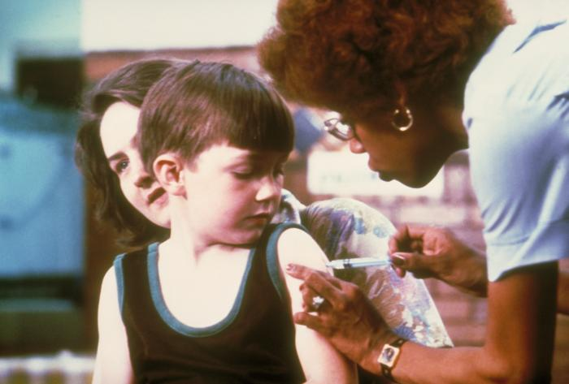
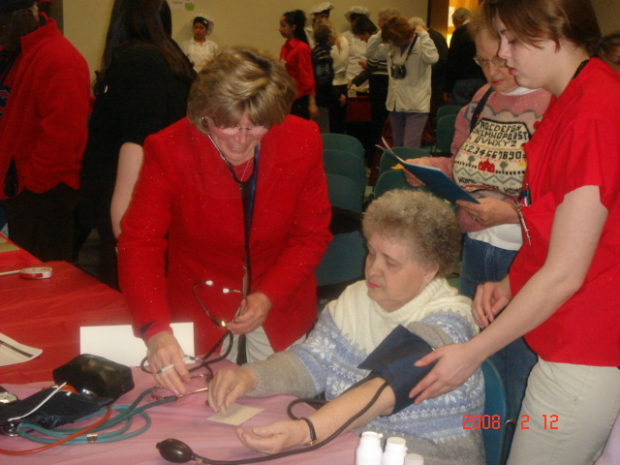

Practice
Notes:
24

Slide 25
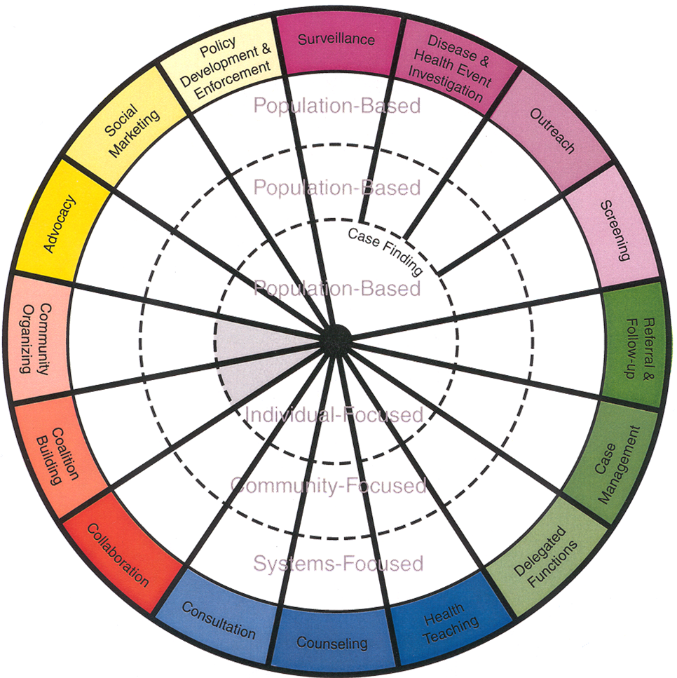
Scope of Practice

Slide 26
Scope of PHN Practice
 | 2010 | Increase / Decrease
Surveillance, Disease Investigations Outreach, Screening, and Case finding | 94% | h
Referral and Follow up, Case Management and Delegated Function | 91% | h
Health Teaching, Counseling and Consultation | 89% | n
Collaboration, Coalition Building and Community Organization | 81% | h
Advocacy, Social Marketing and Policy Development | 72% | h

Slide 27
Screenings/Clinics/Programs

Slide 28
Screenings/Clinics/Programs

Slide 29
Screenings/Clinics/Programs

Slide 30
Screenings/Clinics/Programs

Slide 31
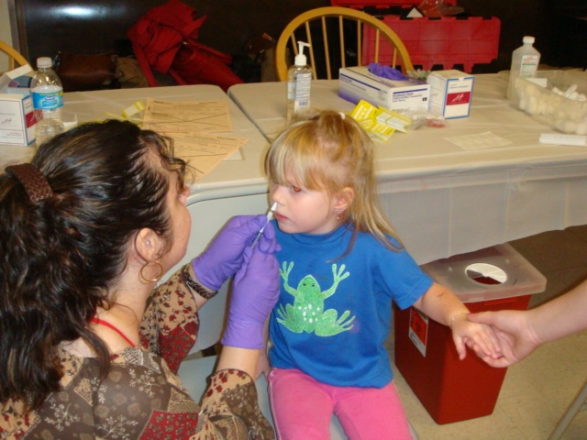
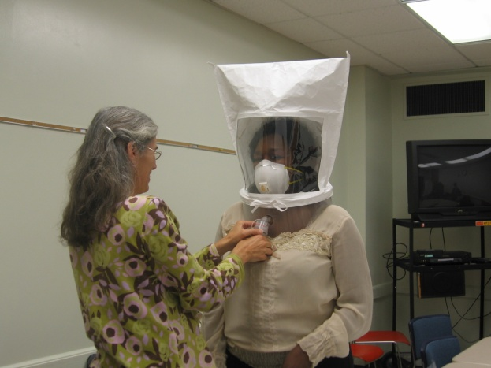
Emergency Preparedness and Response
Training | 2006 | 2010
Behavioral Health Response | 16% | 56%
Mass Dispensing Site (EDS) | 49% | 69%
Personal Protective Equipment | 34% | 61%

Slide 32
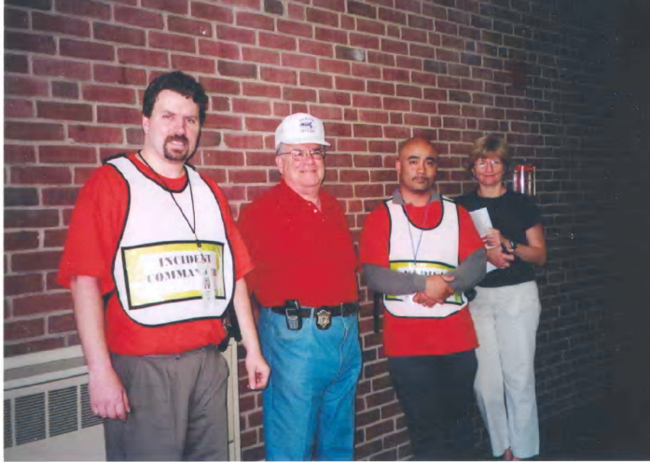
Emergency Preparedness and Response
Training | 2006 | 2010
Incident Command System (ICS) | 58% | 80%
Notes:
32

Slide 33



Emergency Preparedness and Response
Training | 2006 | 2010
Health and Homeland Alert Network (HHAN) | 43% | 55%
Risk Communication | 45% | 59%
Notes:
33

Slide 34
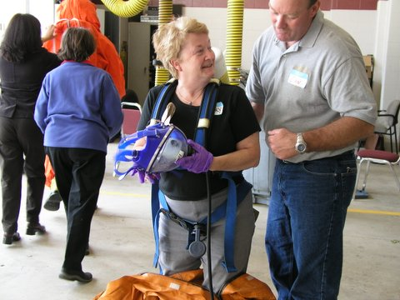
Emergency Preparedness and Response
Training | 2006 | 2010
Local Emergency Planning Committee (LEPC) | 41% | 64%
Drill Participation | 36% | 69%

Slide 35







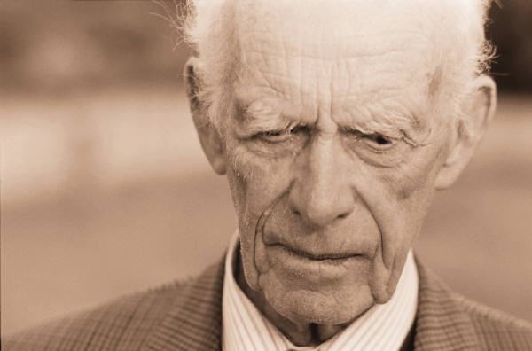


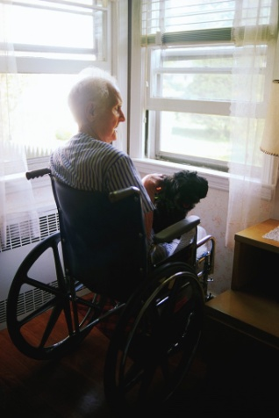
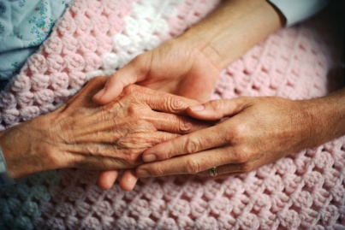


Populations Served

Slide 36
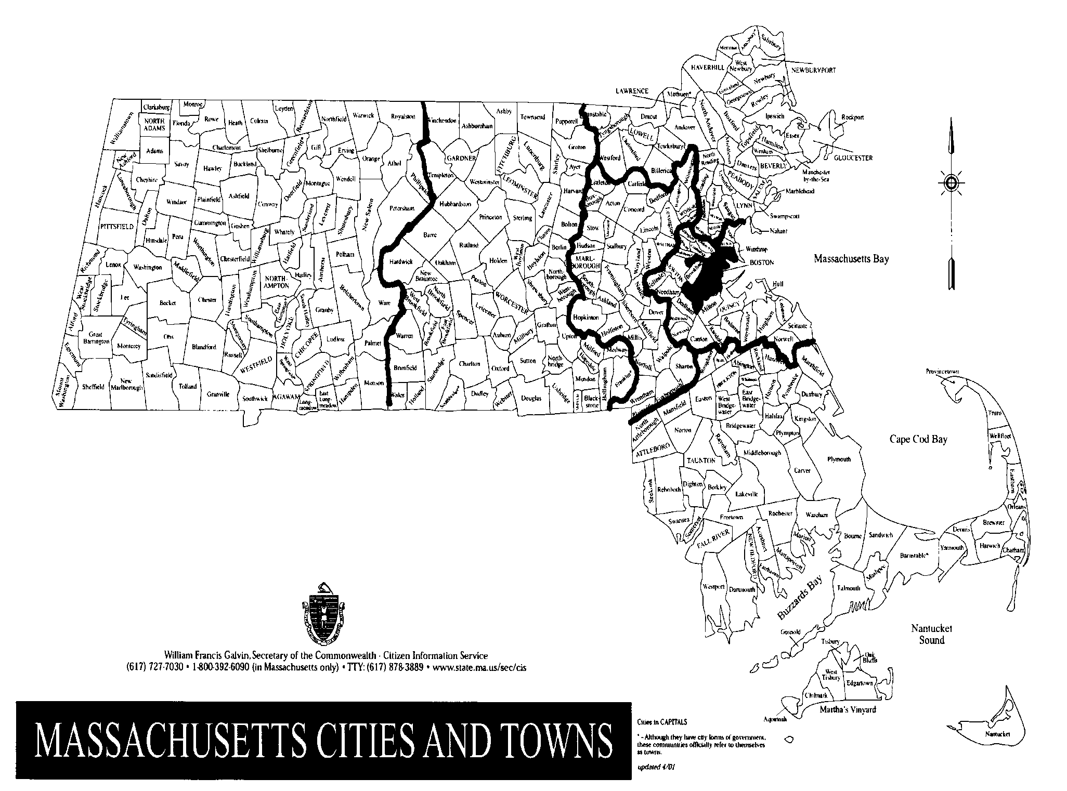
? 90 towns
90

Slide 37
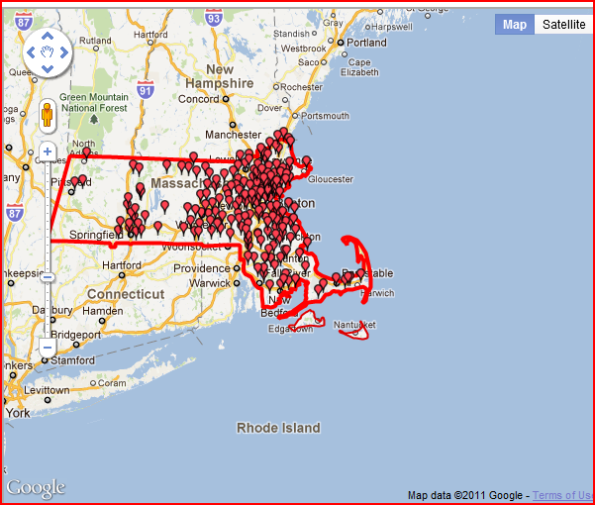
Cities & Towns Population over 6000
http://www.city-data.com/city/Massachusetts.html

Slide 38
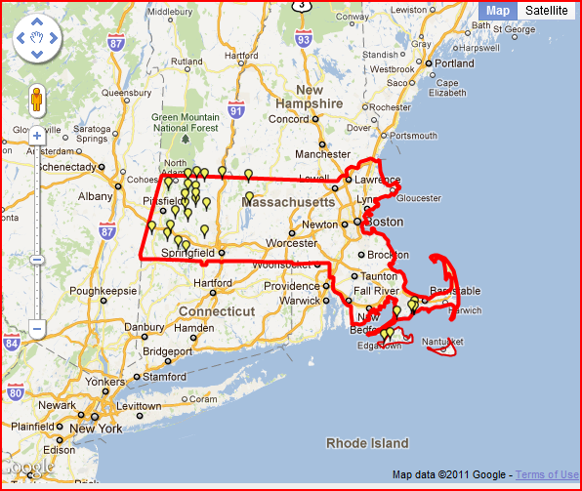
Cities & Towns 1000 population or less
http://www.city-data.com/city/Massachusetts.html

Slide 39
National Recommendation
1 PHN per 5000

Slide 40
Examples and
Anecdotes

Slide 41
Examples
Town 1 PHN: 6,500 population
1 PHN / 6,500
  Town/City 2 PHNs: 65,000 population
  1 PHN / 32,500

Slide 42
Anecdotes
One larger city had a major reduction
(6 PHNs down to 2 PHNs)
1 PHN / 30,000 to 1 PHN / 90,000
Another large city has had a reduction
1 PHN / 10,000 to 1 PHN / 12,000
Some towns are without PHN services

Slide 43
What Did We Learn!
About the PHNs
About the tool and collection process

Slide 44
About the PHNs
Education - above national average for BSNs
PHNs are aging in place
Retirement % remains consistent
Salary increased marginally from 2006 to 2010
Growth and Development
  Scope of Practice
  Emergency Preparedness and Response

Slide 45
Tool and Survey Process
Data needs to be more timely
  Readiness of electronic methods and systems
  Website advances
Did not capture PHN to population ratio
  # PHNs with reduced hours
  # Lost PHN positions
  Consolidation of functions or communities

Slide 46
Recommendations 2006
Lead in Workforce Development
Assure Competency and Preparedness
Recruit and Retain PHNs

Slide 47
Recommendations 2010
Maintain local and national alliances
Utilize technologies
Increase attendance at
educational, skill building and
networking sessions

Slide 48
Planning for the Future
Utilize Technologies
  Obtain more timely data survey on-line
  Develop educational opportunities for building informatics skills and competencies
  Meet the state’s mandated electronic reporting
Contribute Nationally
  Continue to document services provided
  Improve ability to define the denominator

Slide 49
Questions or Comments
Massachusetts Association of Public Health Nurses www.maphn.org
THANK YOU

