Slide 1
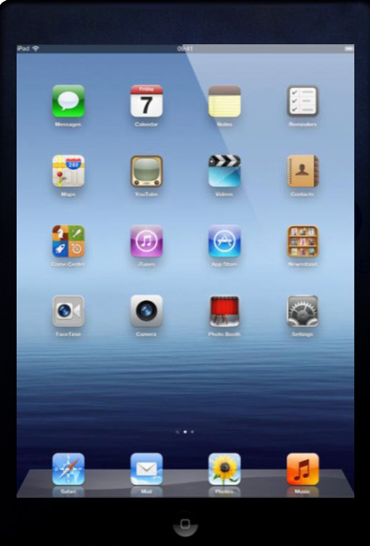
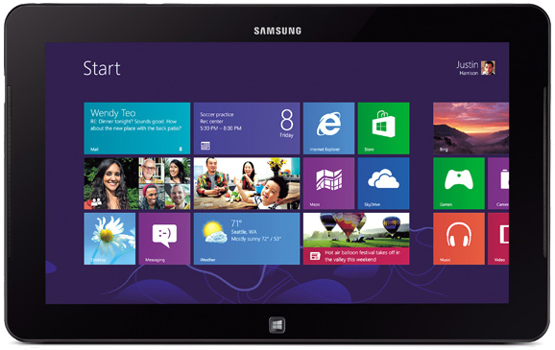
Mobile Applications for Emergency Preparedness
Massachusetts Emergency Preparedness Region 4b
Jennifer Brais, MPH November 2014

Slide 2
Utility
These applications provide functional assistance with useful application to emergency situations

Slide 3
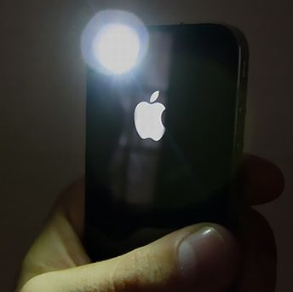
Flashlight
Free application that comes pre-installed on most mobile devices
Everyone should have a flashlight application on their phone – if you don’t have one get one
Flashlight has practical applications to everyday life
Flashlight is very useful if you are in an emergency situation and do not have an actual flashlight

Slide 4
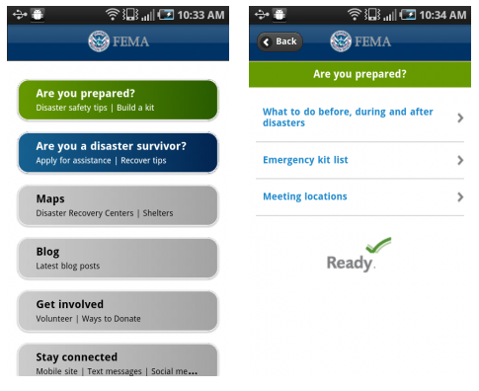
FEMA Mobile App
Free app available on iPhone, Android and Blackberry devices
Disaster safety tips
Interactive emergency supply kit list
Storable emergency meeting place locations
Map with open FEMA shelters and recovery centers
Disaster reporter feature

Slide 5
Dropbox
Free “cloud” storage – 2GB of free space with quick ways to earn extra storage
Put files in your Dropbox and access them from wherever you are
Edit files in your box allows real time edits that other users with access to the document can see instantly
Seamless sharing of documents with others – you control who can see documents
Share a folder or a single file – set expiration dates for how long the person can view the file/folder

Slide 6
Google Drive
15GB of free storage across your Google Account (Gmail, Google drive, Google + photos, etc
Save and access your files from anywhere on both mobile and desktop devices
Share files – make them public or share with specific people and limit whether those people can view, edit, comment, or all 3
Allows for real time changes – all users who the file is shared with can instantly see changes
Includes a chat feature that allows you to message with others viewing the document

Slide 7
Google Maps
Free mobile app
Search for places and addresses
Choose to view in map view, satellite view, or street view
Get directions
See evacuation perimeters
Share and embed maps
Distance measurement ruler

Slide 8
Document Scanner Apps
Mobile apps that range from free to a small fee
Allows you to use the camera on your phone to take a picture of a document and create a PDF
Great for when you need to share information with others when you are unable to reach a physical scanner
Convert physical handouts/information into a digital version that you can share with others

Slide 9
Screen Capture
Not an app but a function of your mobile device
Take a picture of what is on your screen
On iPhone click the home button & the power button simultaneously, the captured image will be saved in your photos – you should hear a shutter noise and the screen should flash
On most Android devices you simultaneously push the down volume button and home button – you should hear a shutter noise and the screen should flash

Slide 10
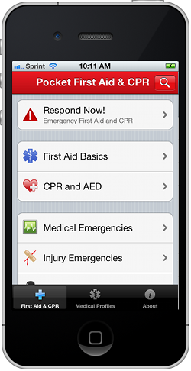
Information
Mobile applications that provide users with emergency preparedness information

Slide 11
Red Cross Mobile Apps
A series of free mobile apps from Red Cross
Everyday Apps: First Aid, Blood, Pet First Aid, Team Red Cross, and Swim
Natural Disaster Apps: Earthquake, Hurricane, Tornado, Flood, Wildfire, and Shelter
Apps are also available in Spanish

Slide 12
American Heart Association Pocket First Aid & CPR
Free mobile app developed by the American Heart Association
Latest up-to-date emergency info from the American Heart Association
Review first aid procedures anywhere, anytime
Hundreds of pages of information with illustrations and videos, including topics such as:
CPR, choking, bites, bruises, burns, seizures, diabetic emergencies, and more.

Slide 13
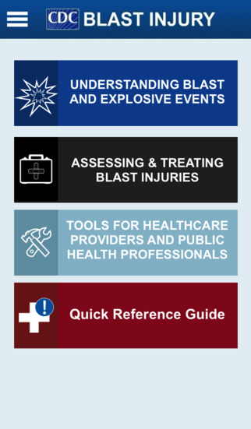
CDC Blast Injury
Available on Apple devices
Designed to help healthcare providers and public health professionals treat injuries, prepare for blast events, and save lives.

Slide 14
Radiation Emergency Medical Management
Available on Android and Apple
Clinical diagnosis and treatment of radiation injury during radiological and nuclear emergencies
Just-in-time, evidence-based, usable information with sufficient background and context to make complex issues understandable to those without formal radiation medicine expertise

Slide 15
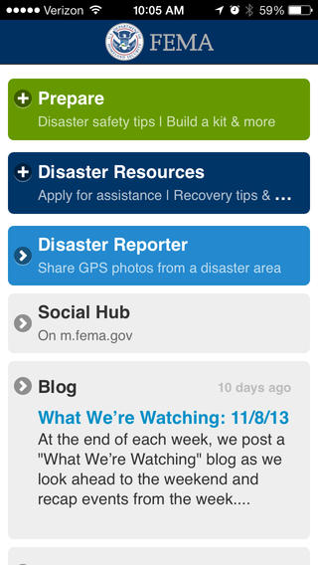
FEMA
Preparedness tips
Interactive checklists
Map with FEMA Disaster Recovery Center locations
Much more!
Notes:
Ce

Slide 16
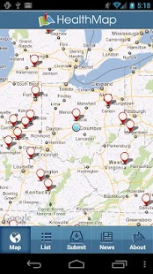
HealthMap: Outbreaks Near Me
Available on Android and Apple devices
Access real-time disease outbreak information
See what outbreaks are in your neighborhood
Search reports and interactive map

Slide 17
WISER
WISER - a system designed to assist emergency responders in hazardous material incidents
Provides a wide range of information on hazardous substances, including substance identification support, physical characteristics, human health information, and containment and suppression advice.

Slide 18
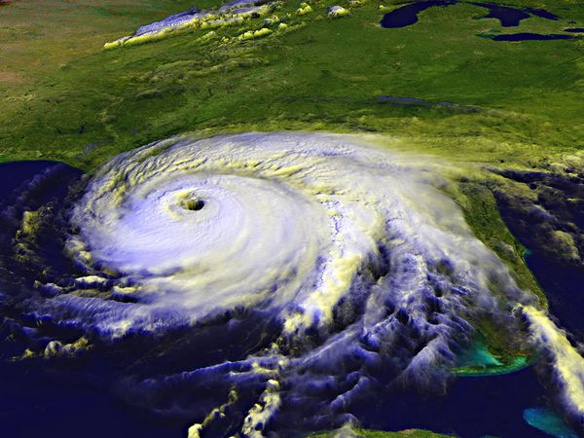
HurricaneSoftware.com
Free mobile app
Get the latest real-time satellite data, the predicted hurricane path, strike possibilities, wind speeds, and more
App allows you to track multiple hurricanes at one time, as well as access historical data for past seasons and individual locations

Slide 19
5-0 Radio Police Scanner
Free app that works with iPhone and iPad
Listen to feeds of police scanners for your town, state, or country
Great for gaining situational awareness first hand from first responder scanners

Slide 20
Police Stream
Free app for Android devices
Listen to police and first responder scanner feeds
Browse scanner feeds, find most listened to feeds, and find feeds that are nearest to your location

Slide 21
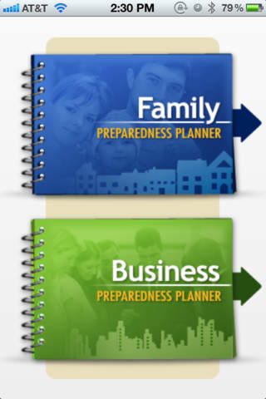
Ready Nova
Available on Android and Apple devices
Helps families and business owners follow basic emergency preparedness practices

Slide 22
Communication
Mobile apps that allow communication during emergency situations

Slide 23
ICE Standard
Free mobile emergency medical information app
ICE = In Case of Emergency
App allows user to create an ICE contact card for their mobile device
Color coding that allows first responders to quickly determining potential issues with the patient based on their medical history

Slide 24
Voxer
Voxer has 3 levels: personal, pro & business
Personal is free, pro is $29.99/annually, and business is $99.95/annually
The Voxer app turns your phone into a push-to-talk walkie talkie, allowing you to send voice messages in near-real time
You can also send text, photos and location information. As a bonus, all conversations are archived for later replay

Slide 25
Skype
A free mobile app
Allows you to voice call, video call, and instant message with contacts who are on Skype
You can pay for other features such as:
Calls to mobile phones and landlines worldwide at low rates
Send text messages for pennies
Get online at over 2 million hotspots worldwide with Skype WiFi

Slide 26
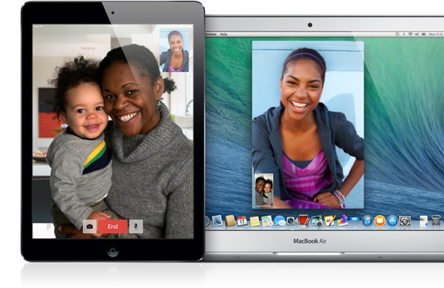
FaceTime
A free app for Apple users
Allows you to video chat with other users of Apple devices
Calls ring on all your Apple devices even if you aren’t signed in.
Call w/ wifi connection on all devices
Call w/ cellular connection on iPhone & iPad

Slide 27
Group Me
Free group messaging mobile app
Works on all mobile platforms and even on your computer
Share photos, videos, and your location
Direct messaging available
Good app for sharing situational awareness updates with all essential people without entering contact info one by one

Slide 28
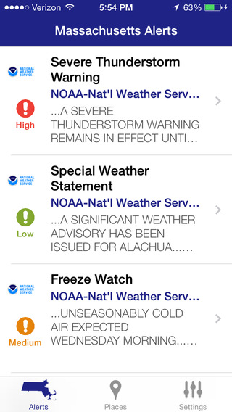
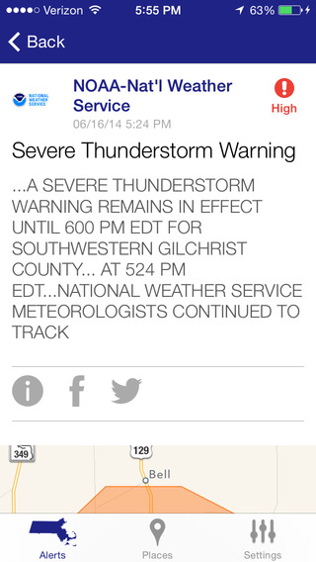
Alert
Mobile applications that alert users during emergency situations in their location

Slide 29
Massachusetts Alerts
Free mobile alert application for MA
Severe weather alerts
Amber alerts
Natural Disaster information including evacuation and shelter-in-place info
Shelter Info
Power outage info
Preparedness/safety tips
Uses phone location services to send:
Public safety alerts relevant to where you are in the state

Slide 30
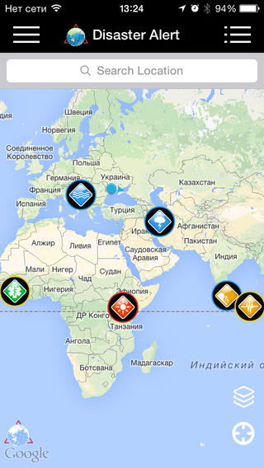
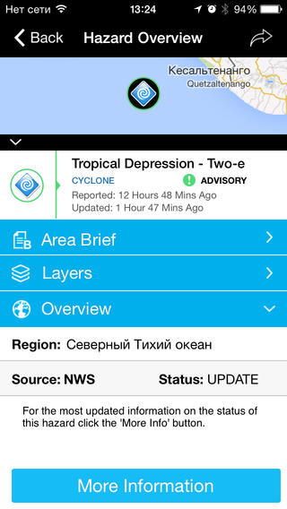
Disaster Alert
Free mobile app
Multi-hazard monitoring application
Provides users with real time access to data on active hazards globally

Slide 31
iHeartRadio
Free radio station app
Listen in to the live broadcasts of hundreds of radio stations across the country, including news/talk stations that provide breaking news coverage of major disasters
Monitor what’s being reported when the power is out or you can’t be near a radio
http://www.iheart.com/

Slide 32
Functional & Access Needs
Apps that can help individuals with functional and/or access needs

Slide 33
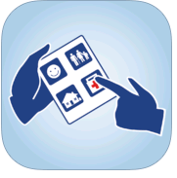
Show Me for Emergencies
Available on Android and Apple devices
Show Me for Emergencies is an essential free app for emergency workers and people with communication needs - like difficulty understanding English, hearing impairments, and cognitive disabilities.
It uses easy-to-understand icons for two-way communication during an emergency.

Slide 34
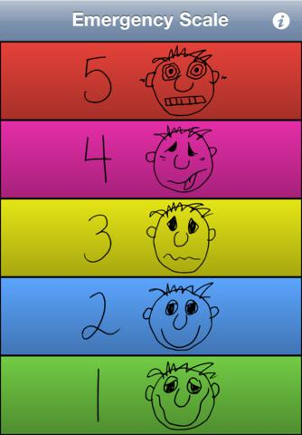
Autism Help App
The Autism Help App assists individuals with Autism Spectrum Disorders (ASD) and other disabilities to communicate and regulate in emergency situations
Available on Android and Apple devices

Slide 35
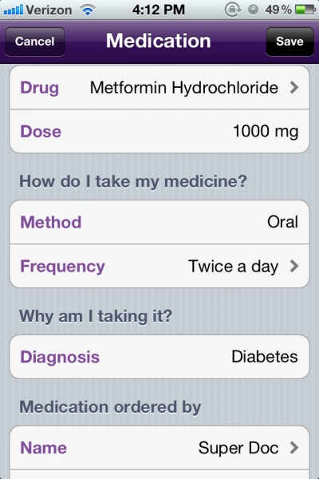
AMA My Medications
$.99 for Apple Devices only
Keep track of medications, doctors, pharmacies, emergency contacts, allergies, immunizations and more

Slide 36
SAMSHA Disaster App
Free on Android, Apple and Blackberry devices
In a disaster, it's essential that behavioral health responders have the resources they need—when and where they need them.
Users can navigate:
Pre-deployment preparation
On-the-ground assistance
Post-deployment resources, and more
Users also can share resources, like tips for helping survivors cope, and find local behavioral health services. And, self-care support for responders is available at all stages of deployment.

Slide 37
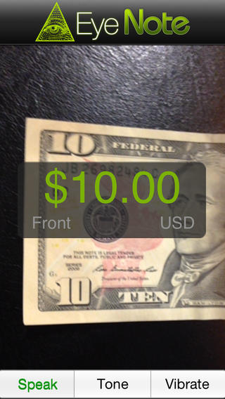
Eyenote Money Reader
A free app on Apple devices
Denominates Federal Reserve Notes (U.S. paper currency) as an aid for the blind or visually impaired to increase accessibility.
Users can have the denomination of a note scanned and communicated back to the user.

Slide 38
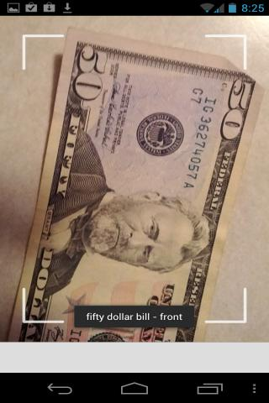
IDEAL Currency Identifier
A free app for Android devices
Identifies US paper currency and have text displayed or denomination spoken

Slide 39
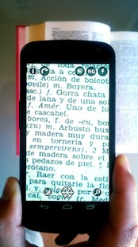
Magnifier
Free on Android devices
Onscreen zoom & lighting controls
Negative mode
Freeze & Save images

Slide 40
Magnifier Flash
$.99 on Apple devices
Magnify text with light
6x magnification
Snap & save

Slide 41
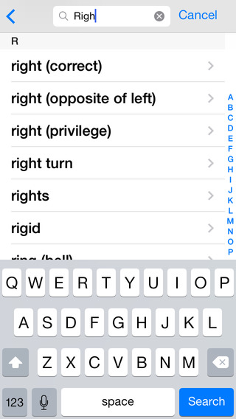
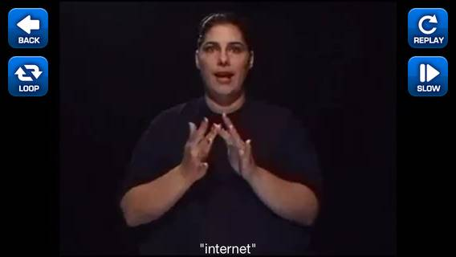
ASL Dictionary
$4.99 on Apple and Android devices
Over 5,200 signs from a-z
Search the word then play the video for the ASL translation

Slide 42
Voice Brief
$2.99 on Apple devices
Text-to-speech assistant
Reads aloud everything on your mobile device from Facebook to Email
Can read anything you type
Natural sounding voice

