Slide 1
Legal Authority of Boards of Health
Cheryl sbarra, j.d., Executive Director and Senior staff attorney
Massachusetts association of health boards
MAPHN conference
May 3, 2023

Slide 2
disclaimer
This information is provided for educational purposes only. It is not intended to constitute legal advice.

Slide 3
Legal Authority to Regulate Public Health and Safety – G.L. c. 111, § 31
Federal – minimum standards
State
“Through the plain language of G.L. c. 111, §31, the Legislature has delegated to boards of health the authority to “make reasonable health regulations.” Tri-Nel Management, Inc. v. Board of Health of Barnstable, 433 Mass 217 (2001).
“The protection of public health is within the police power of the municipality to protect the health, safety and welfare of its residents.” Druzik et al v. Board of Health of Haverhill, 324 Mass. 129 (1949).
It is a widely accepted function of government to protect public health, even at the expense of an individual’s freedom. (Id.)
“The right to engage in business must yield to the paramount right of government to protect the public health by any rational means.” (Id.)

Slide 4
Massachusetts Supreme Judicial Court (SJC) has consistently upheld board of health authority to enact health regulations
Board of health regulations “stand on the same footing as would a statute, ordinance or by-law.” (Druzik v. Board of Health of Haverhill, 324 Mass. 129, 138 (1949)).
“All rational presumptions are made in favor of the validity of [the regulations].” Id.
Courts will only strike a board of health regulation when the challenger proves, on the record, “the absence of any conceivable ground upon which [the regulation] may be upheld.” (Arthur D. Little, Inc. v. Com’r of Health for Cambridge, 395 Mass. 535 (1985)).
“A party challenging a board of health regulation must prove that it is illegal, arbitrary, or capricious, and must establish an absence of any conceivable grounds upon which the regulation may be upheld.” (Padden v. West Boylston, 445 Mass. 1104 (2005)).

Slide 5
United Comb & Novelty Corp. vs. City of Leominster Board of Health (17 Mass. L. Rep. 233 (2004))
“When applying the arbitrary and capricious standard, the reviewing court is not authorized to weigh evidence, find facts, exercise discretion, or substitute its judgment for that of the administrative body.”

Slide 6
Cumberland Farms, Inc. vs. Town of Yarmouth Board of Health
Barnstable Superior Court decision – September 27, 2018.
Decision in favor of Board of Health’s decision to fine and suspend Cumberland Farm’s tobacco sales permit for selling a flavored tobacco product.
Smelling the product to determine whether it is flavored is proper.
CF lost their appeal.

Slide 7
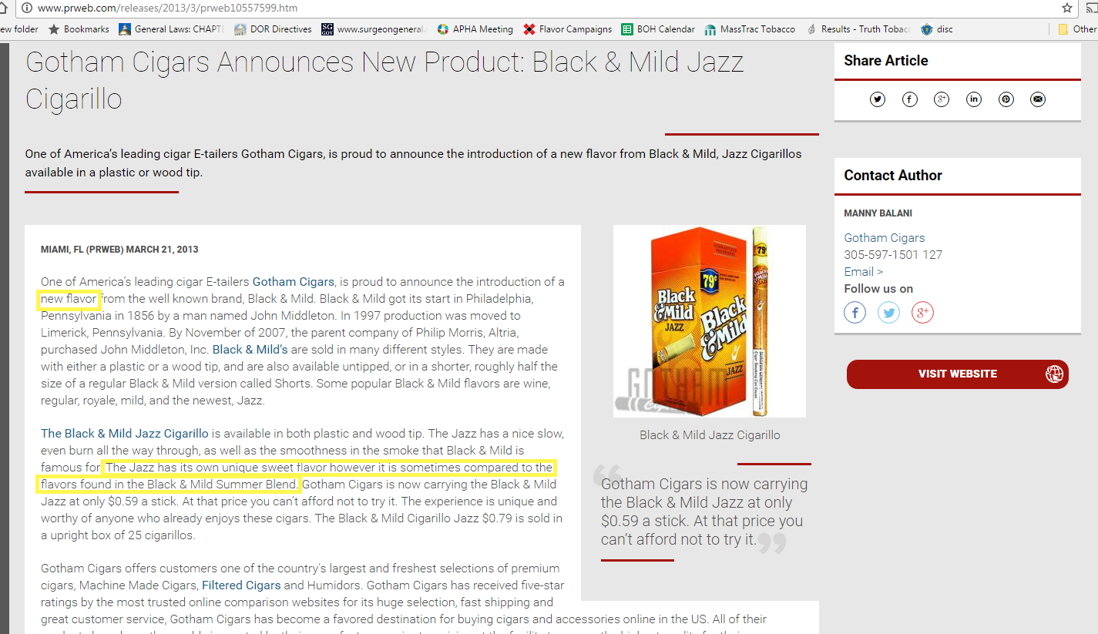

Slide 8
The language of the local regulation “does not require any particular training or scientific expertise to determine if there is a ‘distinguishable aroma’ [p]erceived by either the sense of smell or taste.”
In fact, smell is used all the time by health inspectors.
Ventilation in restaurants to prevent “obnoxious odors” (Federal Food Code)
Pool flotation devices can’t smell of mildew 105 CMR 158.043.
Waste receptacles in multi-unit housing are sufficient to contain odors (105 CMR 410.600).
From Public Health Law Center’s Amicus Brief

Slide 9
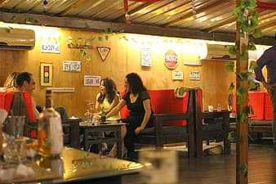
American Lithuanian Naturalization Club, Athol, Mass., Inc & others vs. Board of Health of Athol & another (446 Mass. 310 (2006))
Athol Board of Health had the authority to prohibit smoking in private clubs pursuant to G.L. c. 111, § 31.
Focus of public health is to protect the health of every member of the community, regardless of geography or location.
Helmets, smoke detectors, lead paint.

Slide 10
Just because you can doesn’t mean you should.

Slide 11
Limitations/Consideration: When do you act and when do you not?
Is there a state or federal law that prevents you from acting (preemption)?
Risk assessment
Is there a risk of harm to others?
Is the risk to those who are more susceptible to harm?
Is the risk to an individual?

Slide 12
Factors to consider
Is the intervention going to be effective?
What is the burden to the individual?
Is it fair and reasonable?

Slide 13
Legal authority (continued)
Local
State legislature delegated its power.
Extent of delegation varies.
Sharing of power.
Sanitary code
Delegation to locals as primary enforcing agent.
Smokefree Workplace Law
Locals have authority to strengthen state law.
No preemption

Slide 14
Chapter 111, §31- general regulatory authority
Additional, specific authority:
§§ 31A and 31B: removal, transportation and disposal of refuse.
§§ 122,123: nuisances.
§127: house drainage and sewer connections.
§ 127A: the sanitary code, including housing code and food code.
§§ 143 – 150: noisome/offensive trades.

Slide 15
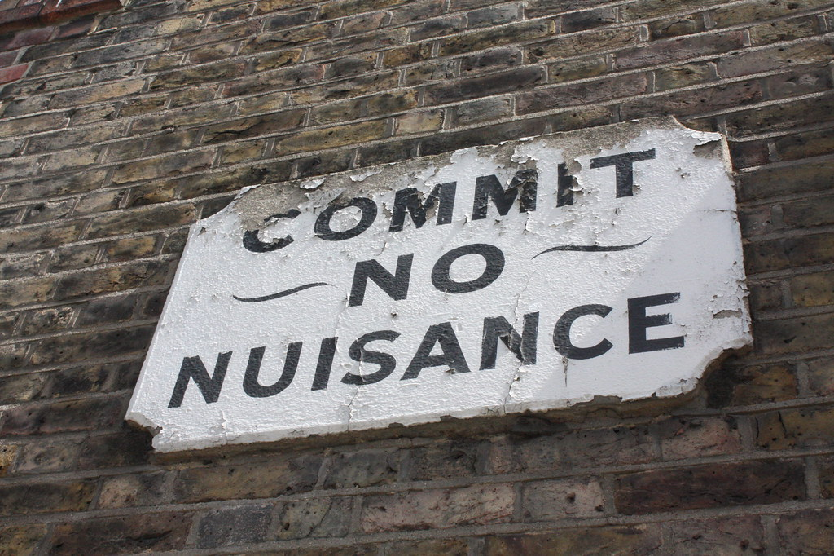
Nuisance Law Chapter 111, §§122, 123
“The board of health shall examine into all nuisances, sources of filth and causes of sickness within its town, which may, in its opinion be injurious to the public health.”
“There is perhaps no more impenetrable jungle in the entire law than that which surrounds the word ‘nuisance.’”

Slide 16
Nuisance (continued)
Board of Health’s obligations:
“examine, destroy, remove and prevent as the case may require.”
“make regulations relative thereto.”
Exceptions:
Activities that are “generally acceptable farming procedures.”

Slide 17
Determining a public health nuisance
In the Board’s opinion
Judgement call
Based on public health principles
Factors to consider:
Does the condition affect the public?
Is the nuisance contained to one individual or household?
Could the nuisance spread to neighboring individuals or households?
Could the individual spread the nuisance in the community?
Minnesota Public Health Nuisance Handbook

Slide 18
If yes, does the condition affect “health?”
Is there a real or potential health risk?
Can the condition cause or be expected to cause transmission of disease?
Does the condition cause or is there a potential for the condition to cause trauma or injury to the public?
Does the condition constitute, or is there potential for the condition to constitute an exposure to hazardous elements or substances that could adversely affect the health of the public?
Is the subject of the complaint an unsafe or potentially unsafe structural or environmental conditions?

Slide 19
If Board determines a nuisance exists G.L. c. 111, § 123
Issue Cease and Desist Order
To remove the nuisance within 24 hours or within a reasonable amount of time.
Penalty – not more than $1000 for every day during which the individual knowingly violates the order.
Hearing to review plan to remove the nuisance is an option.
Templates available
Generic pandemic order
Tobacco sales order
Can create other orders

Slide 20
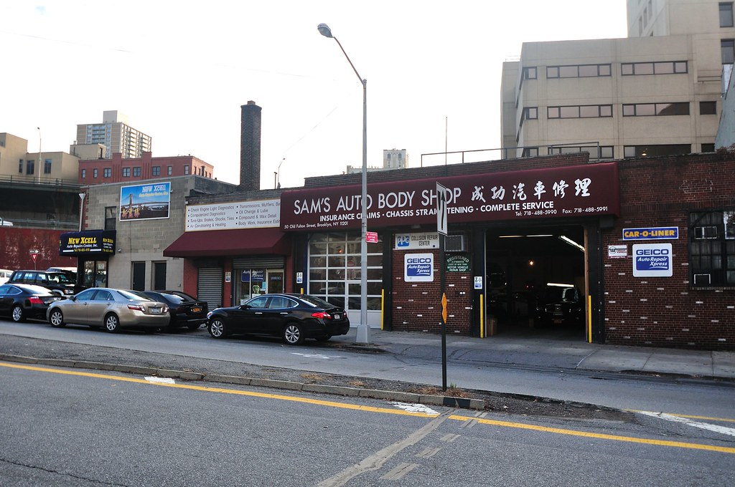
Noisome Trade, Ch. 111, §§ 143-150
No trade or business that results in or MAY result in a nuisance, be harmful to the inhabitants, injurious to their estates, dangerous to the public health, or may be attended by noisome and injurious odors shall be established except in such a location as may be assigned by the board of health after a hearing.

Slide 21
No such business shall be established until the Board holds a hearing.
Does not apply to hazardous waste facilities, § 150B, or refuse treatment or disposal facilities, § 150A.
Cannot come into town until Board assigns a site.
Board can also prohibit business.
Zoning regulations might constrain siting process.
Consult with municipal attorney.
Piggeries are, by definition, noisome trades.
However, if on 5 or more acres, they are farms.
Examples:
Fat rendering plant
Manufacturing of fish meal and fish oil
Auto body shops

Slide 22
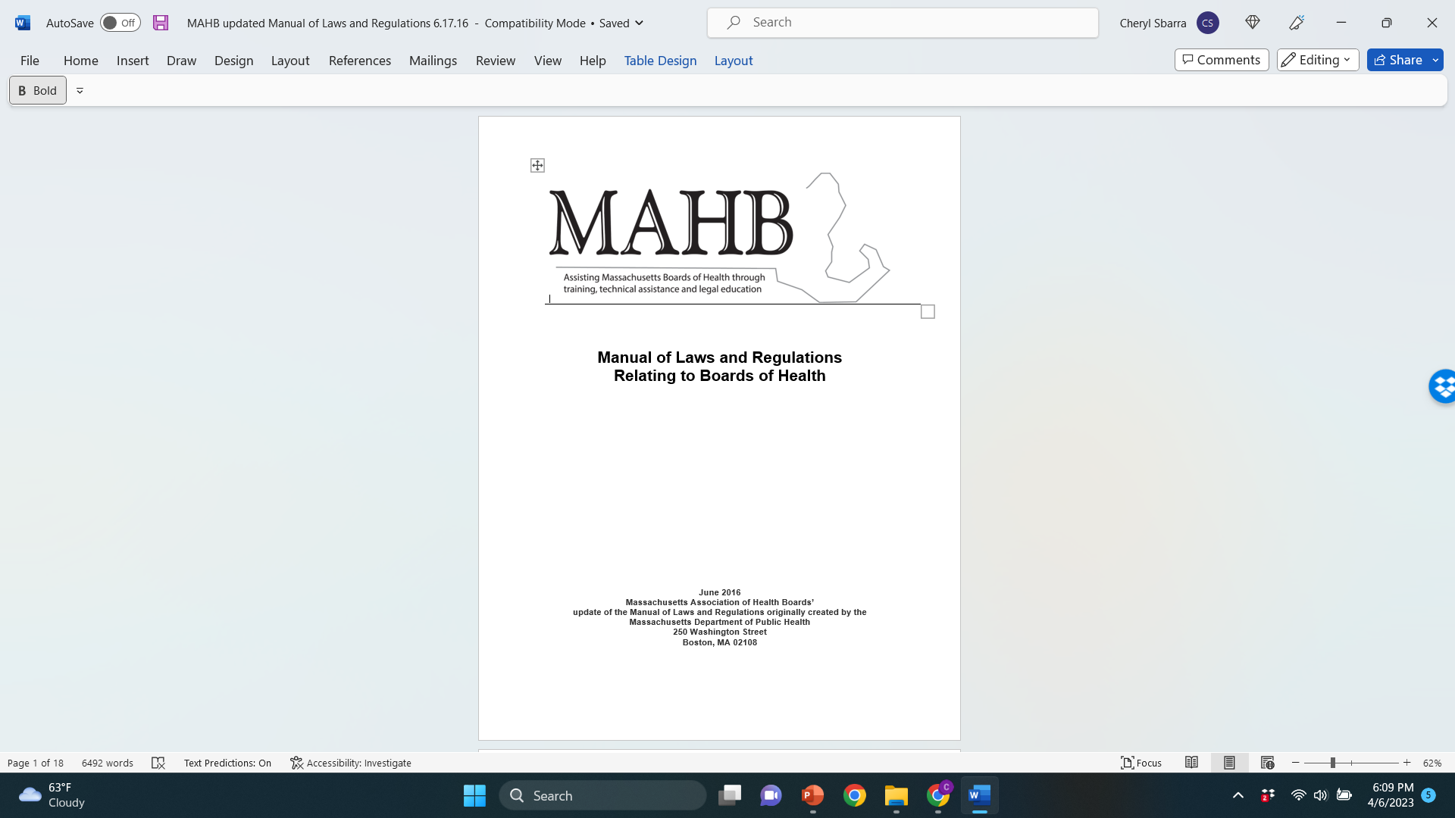

Slide 23
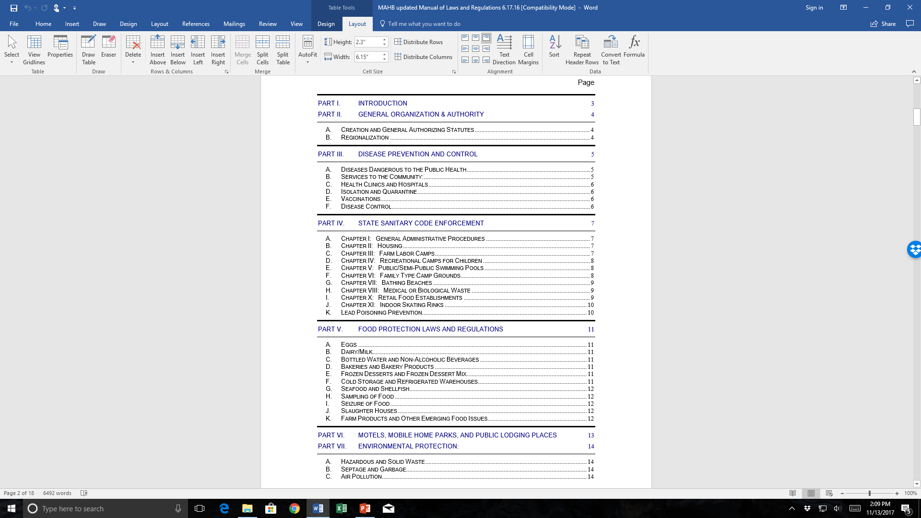
Assuring safe drinking water
Lead inspections
State sanitary code
Diseases dangerous to public health.
Food protection laws and regulations, including restaurant inspections
Isolation and quarantine
Housing code
Vaccinations
Septic systems and private wells
Medical and Biological Waste, understanding what it is and what it is NOT.
Notes:
20 - Here are 52 separate areas that YOU are obligated to enforce

Slide 24
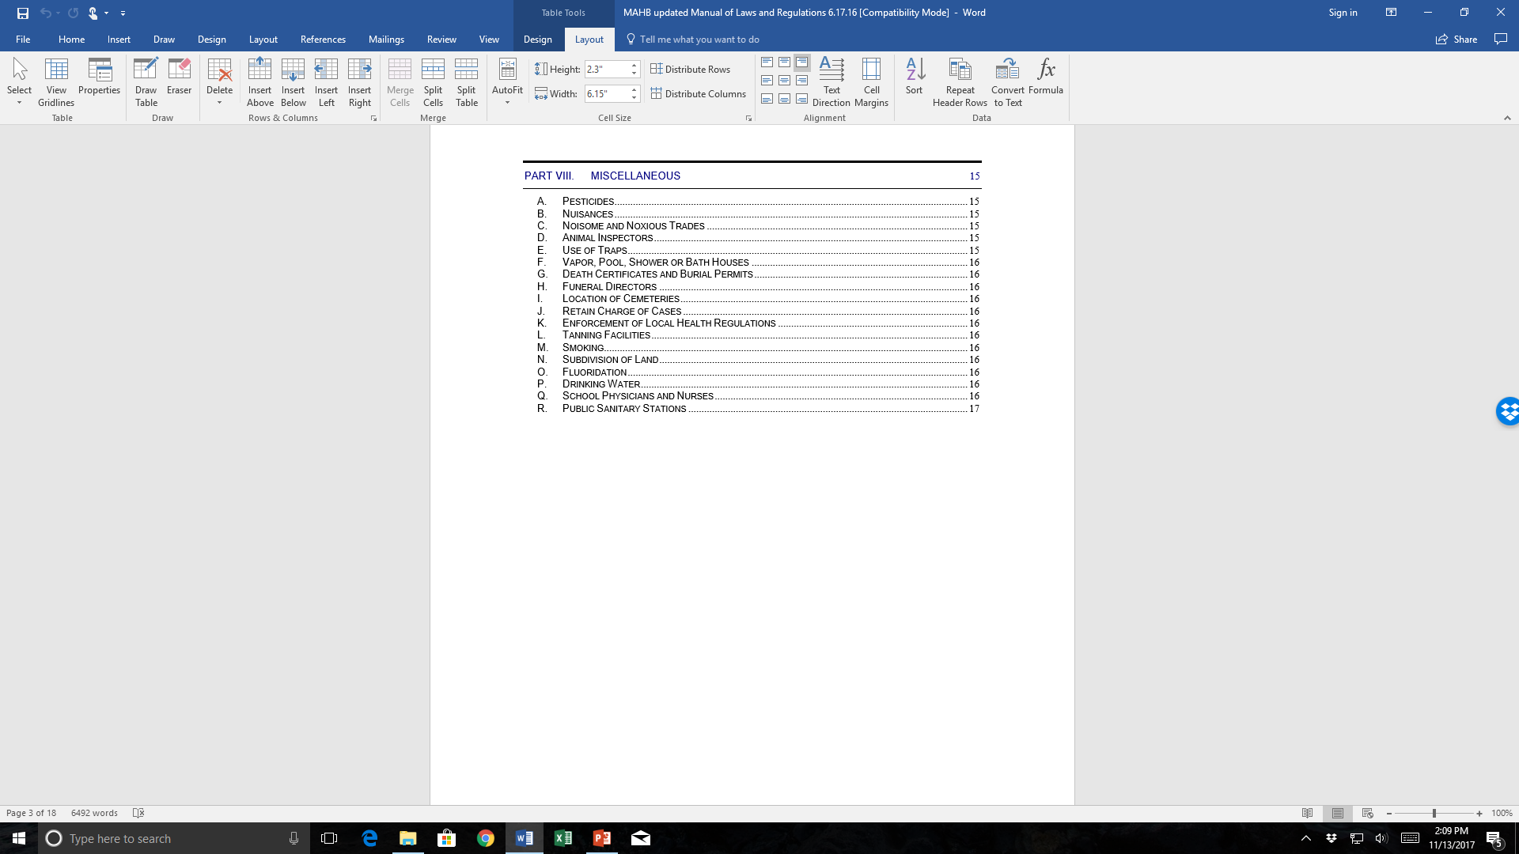
Enforcing state and local regulations
Tobacco sales law banning all flavored products, including menthol
Knowledge base required is great.
Notes:
21 – Just show

Slide 25
Isolation and Quarantine – Legal Issues and Potential Solutions
Goal:
Compliance, not punishment
Comprehensive instructions for voluntary compliance
Contact tracing strategies
Public health nurses
Community tracing collaborative
Enforcement challenges when faced with non-compliance
Positive FedEx driver; teacher; health care worker, etc.
Antiquated laws in MA
1907 most recent amendment – reimbursements of wages not more than $2 a day.
1938 most recent case law – whether a painter was a “wage earner”
Very little experience and/or guidance

Slide 26
Isolation and Quarantine (cont.)
Used nuisance statute
May be injurious to the public health
Fine not to exceed $1000
Drafted comprehensive Notice of Violation and Cease and Desist Orders
Includes violations of Isolation and Quarantine

Slide 27
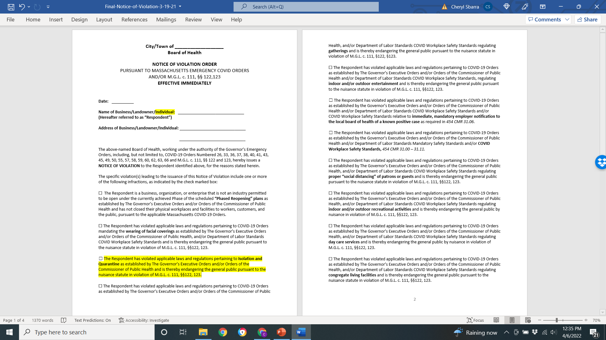

Slide 28
Liability Protections for Boards of Health and Staff

Slide 29
HIPAA AND PRIVACY RIGHTS
Health Insurance Portability Accountability Act (HIPAA)
Creates national standards to protect individuals’ medical records and other personal health information.
Establishes safeguards that health care providers must do to protect the privacy of health information.
Covered entities:
Public and private insurance
Health care providers
Hospitals
When transmitting health information electronically

Slide 30
Are Boards of Health “Health Care Providers”
Only when they provide the following:
Vaccination clinics
Sexually transmitted infection screening, or
Any other such functions AND
Need to submit claims to health insurance programs electronically.
Including Medicaid or Children’s Health Insurance Program services that are reimbursable.
Infectious, communicable disease surveillance programs are not health care delivery functions of a Board of Health, and therefore, are not subject to HIPAA.

Slide 31
Commissioner’s Order 3.18.20
Local boards of health shall disclose to the official with the responsibility for administering the response to emergency calls in their jurisdiction (Receiving Entity) the address of persons who the local board of health has been informed have tested positive for COVID-19.
The local board of health shall disclose the address only, not the name or any other identifying information.

Slide 32
Boards of Health are Public Health Agencies
HIPAA explicitly states it is not intended to limit existing public health agencies activities concerning:
Surveillance, investigation and intervention.
Traditional reporting relationships.
If requested, must provide individuals an accounting of information provided to DPH.
If asked for information:
Dr. Katie Brown
Judgment call

Slide 33
Legal Liability Protection
Massachusetts Tort Claims Act, G.L. Chapter 258
Public employers are liable for harm caused by the negligent or wrongful act for failure to act of any public employee who acted within the scope of his/her employment. No personal liability.
Intentional wrongdoing is not covered.
Negligent inspection v. inspection while impaired
Civil rights violation.

Slide 34
Who is a public employer
Commonwealth of Massachusetts
City, town, county
Public health multi-municipal collaboratives (PHE grantees)

Slide 35
Covered public employees – 3-step analysis
Are you an “public employee?”
Are you “subject to the direction and control” of a “public employer?”
Was the act (or failure to act) within the scope of your employment?

Slide 36
1. Public Employee
Officer or employee of a public employer
Elected or appointed officials
Full or part time
Temporary or permanent
Compensated or uncompensated

Slide 37
2. Subject to direction or control of public employer?
Question of fact in each case.
Paid employees doing regular job are under the direction and control.
Board of Health members are under direction and control of municipality.
Working on behalf of municipality.
Representing municipality.

Slide 38
3. Were you acting within the scope of your employment?
Was the conduct in question what you were hired to do?
Did it occur within authorized time and space?
Was it motivated by a purpose to serve employer?
Travel to and from home is generally not within scope of employment.
Merely being “on call” does not place you within the scope of employment.
Once you get the call . . .

Slide 39
Bottom line
If you are a public employee (BOH member or staff) and you are acting within the scope of your employment, the municipality must defend you.
Unless you did something intentional, horrendous and very, very wrong, including violating civil rights. you are a public employee (BOH member or staff) and you are acting within the scope of your employment, the municipality must defend you.
Unless you did something intentional, horrendous and very, very wrong, including violating civil rights.

Slide 40
Discretionary function
Chapter 258, Section 10(b): Protects public employers (cities, towns, boards of health) from any claim based upon the performance or failure to perform a discretionary function . . . Whether or not the discretion involved is abused.
Purpose: to avoid allowing civil claims to be “used as a monkey wrench” in the machinery of government decisions making. (Cady v. Plymouth-Carver Regional School District 1983).

Slide 41
Definition of “discretionary function”
Does the government actor have any discretion at all as to what course of action to follow or is the course of action determined by statute or regulation.
For instance – state tobacco sales law calls for $1000 fine and a permit suspension for selling tobacco to someone under 21.
Weighing alternatives and making choices with respect to public policy and planning.

Slide 42
Example of Discretionary Function function
City’s exercise of its discretion in deciding not to incur cost of erecting a fence on stairs near children’s playground, or to remove snow from the stairs, was based on a determination of allocation of limited resources, which was an integral part of its governmental policy making or planning function, and thus tort action for wrongful death of a child was barred, even if city’s decisions was ill-advised or unreasonable. Barrett v. City of Lynn (2001).

Slide 43
Not a discretionary function
Negligently supervising a truck driver’s operation of a salt truck “does not appear to have a ‘close nexus to policy making or planning.’” Ku v. Town of Framingham (2004).
Snowplow driver drove in middle of a double solid yellow-lined road at night and town knew this.

Slide 44
Failure to Inspect – Chapter 258, Sec. 10(f)
No liability for failing to inspect, or inadequately or negligently inspecting real or personal property to determine whether the property complies with or violates any “law, regulation, ordinance or code, or contains a hazard to health or safety . . .”
Cited by a municipal attorney.
Does this mean you shouldn’t inspect?

Slide 45
Additional Liability Protections for Vaccination Clinics
Ch. 64 of the Acts of 2020: “An Act to Provide Liability Protections for Health Care Workers and Facilities During the COVID-19 Pandemic”
Provides liability protection for the prescription, administration, delivery, distribution, or dispensing of COVID-19 vaccine by a health care professional or health care facility;
Extends to volunteer organizations that make their facilities available to support activities during the COVID-19 emergencies.
Federal Public Readiness and Emergency Preparedness Act (PREP Act).
Declaration issued by the U.S. Department of Health and Human Services (HHS) providing liability protection from “countermeasures” (vaccines) against diseases or other threats or public health emergencies, including the distribution, administration, and use of vaccines.
Covers program planners, administrators, and qualified persons who prescribe, administer, and/or dispense vaccines.
National Vaccine Injury Compensation Program for injury or death.
Petition to U.S. Court of Federal Claims – 42 USC 300 AA

Slide 47
Contact information
Cheryl Sbarra, JD
sbarra@mahb.org
(781) 572-5639

